Slide 1
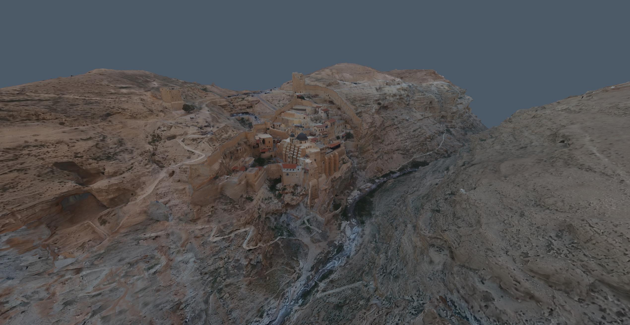
Introduction to rendering with three.js
Alex Zhang
Fraunhofer Workshop 2nd Sep 2021

Slide 2
Overview
Introduction
Tutorial
WebGL and Three.js
The Graphics Pipeline
Coordinate Systems
Perspective Camera
Setup Visual Studio Code
Lights, Materials, Shaders
Create a cube – Vertex and Index buffers
Custom Shader – Lambert shading model
Textures – UV coordinates
Import a GLTF model
Notes:
1. WebGL and Three.js – Show you some cool things you can do with web rendering.
2. The Graphics Pipeline –Learn about the important stages in the graphics pipeline, such as vertex and fragment shaders.
3. Coordinate Systems – How mesh vertices are transformed to the clip coordinate space required by the graphics pipeline.
4. Perspective Camera – How the view and projection matrix is formed from certain camera parameters.
Setup the development environment. Visual Studio Code. Make sure three.js runs on your system.
Try out the three.js renderer. Add a cube mesh, ambient, and direction lights in the scene.
Let’s create your own cube by defining its vertices and indices.
Create a custom vertex and fragment shader to compute Lambert diffuse shading model.
Texture the cube to make it look more like a Minecraft block of dirt. Add the texture coordinates to the mesh.
Use the Three.js GLTF importer to import an awesome looking 3D model.

Slide 3
WebGL and three.js
WebGL – A JavaScript API for 3D graphics rendering
Runs on most modern web browsers
Creates a rendering context within HTML <canvas> element
Three.js – A high-level graphics library based on WebGL
Scene management, cameras, lights, meshes, material
Importing models and textures, controls for camera…
The rendering loop:
Passing scene data to the GPU graphics pipeline every frame
Notes:
The heart of rendering engine is the rendering loop.
Pass scene data such as geometry and textures to the graphics pipeline, and every cycle of the rendering loop renders an image into the framebuffer and displays it.

Slide 4
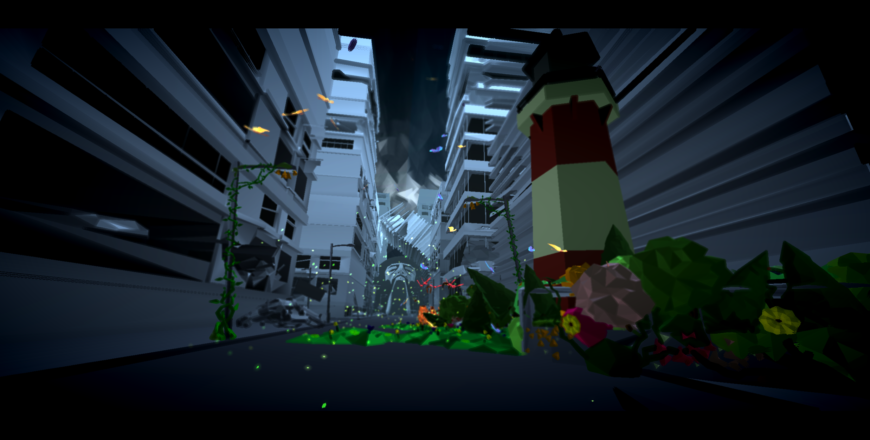
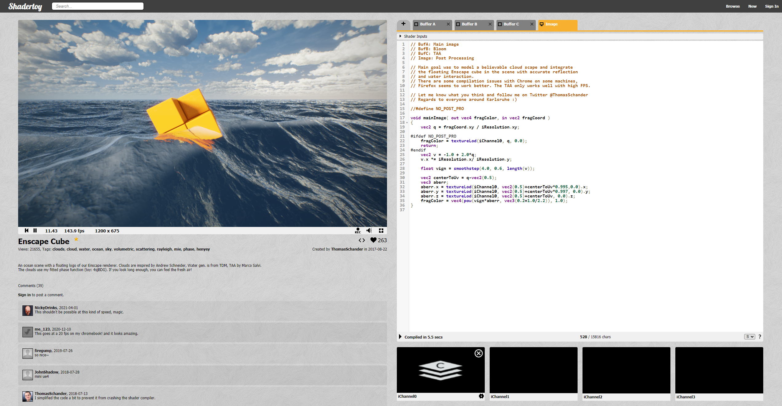
http://www.ro.me/
Interactive music video
https://www.shadertoy.com/
Complex rendering

Slide 5
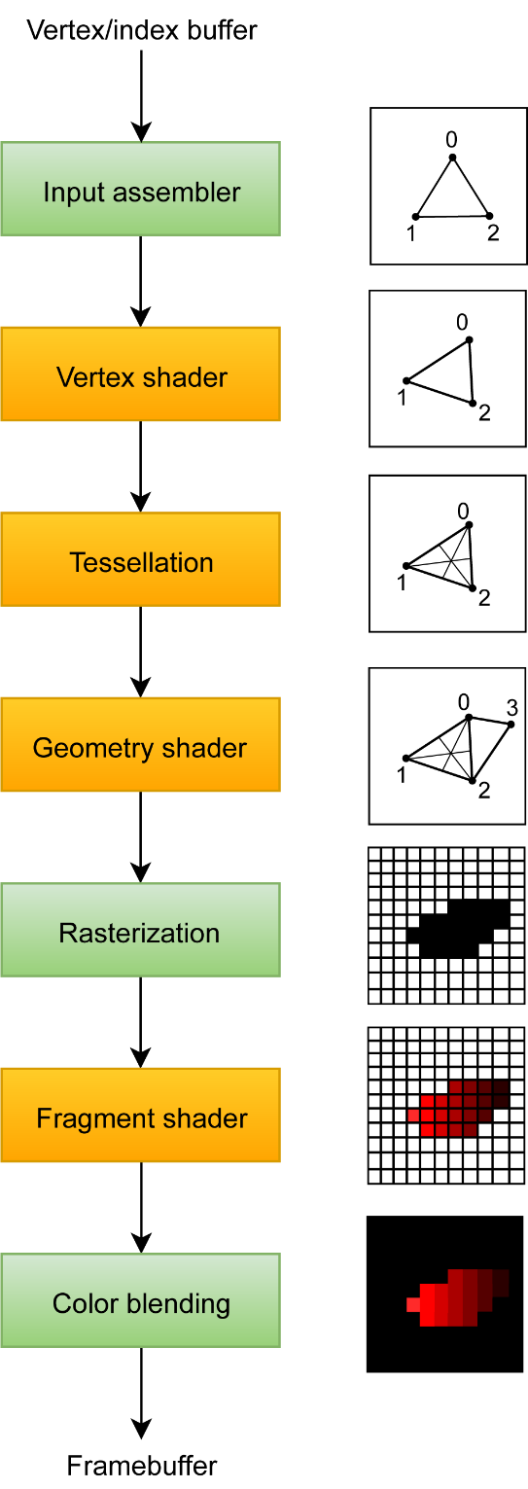
The Graphics Pipeline
Input
A list of mesh vertices (XYZ coordinates)
Three vertices form one triangle primitive
Output
Computed fragment colors (RGB values) of the visible mesh from a particular view
RGB values (rendered image) stored in the framebuffer
Vertex and fragment shaders are mandatory
https://vulkan-tutorial.com/Drawing_a_triangle/Graphics_pipeline_basics/Introduction
Notes:
Pipeline has series of stages where each stage has a specific function and data flows from one stage to the next

Slide 6
Graphics Pipeline Stages
Vertex buffer
An array of coordinate set describing a vertex attribute for each vertices of the model
Vertex attributes can be positions, normals, texture UV coordinates, colors…
3 contiguous vertices forms 1 triangle primitive
 | Array 1 | Array 2 | Array 3
Vertex 1 | {x, y, z} | {u, v} | {r, g, b}
Vertex 2 | {x, y, z} | {u, v} | {r, g, b}
Vertex 3 | {x, y, z} | {u, v} | {r, g, b}
… | … | … | …
https://vulkan-tutorial.com/Drawing_a_triangle/Graphics_pipeline_basics/Introduction

Slide 7
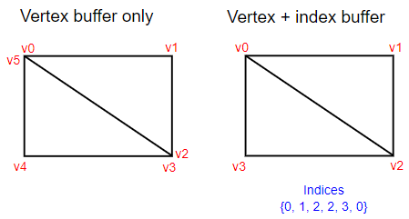
Graphics Pipeline Stages
Index buffer
An array of indices addressing vertices in the vertex buffer to describe the model
Reuse existing vertices to reduce vertex data size
3 addressed contiguous vertices forms 1 triangle primitive
 | Array 1
Index 1 | 3
Index 2 | 1
Index 3 | 2
… | …
https://vulkan-tutorial.com/Vertex_buffers/Index_buffer
https://vulkan-tutorial.com/Drawing_a_triangle/Graphics_pipeline_basics/Introduction

Slide 8
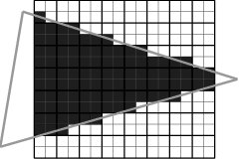
Graphics Pipeline Stages
Vertex shader
A GLSL program that executes operation per vertex
Transform mesh vertices to the clip coordinate space (expected at the end of the vertex shader)
Rasterization
Discretizes triangle primitives into fragments
Linearly interpolates vertex attributes across the fragments
[Moss, Andrew 2007]
https://vulkan-tutorial.com/Drawing_a_triangle/Graphics_pipeline_basics/Introduction
Notes:
The input assembler collects the raw vertex data from the buffers you specify and may also use an index buffer to repeat certain elements without having to duplicate the vertex data itself.
The tessellation shaders allow you to subdivide geometry based on certain rules to increase the mesh quality
The geometry shader is run on every primitive (triangle, line, point) and can discard it or output more primitives.

Slide 9
Graphics Pipeline Stages
Fragment shader
A GLSL program that executes operation per fragment
Compute shading or lighting models
Example inputs to shading models:
Color values (RGB) sampled from a texture
Color values of the light or material
Color values passed from vertex shader
Equation parameters (light intensity etc.)
Output: The color value of each fragment
https://vulkan-tutorial.com/Drawing_a_triangle/Graphics_pipeline_basics/Introduction

Slide 10
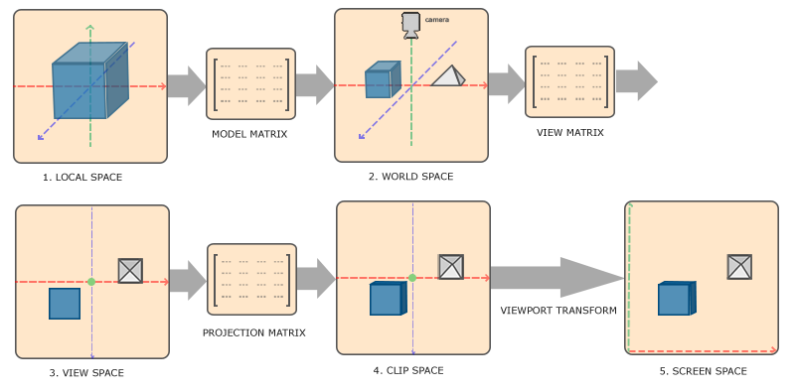
Coordinate Systems
Vertex coordinates are transformed through a series of coordinate systems (spaces)
Certain operations are easier performed in a coordinate space
Organised scene management with many objects
https://learnopengl.com/Getting-started/Coordinate-Systems
Notes:
Remember how at the end of the vertex shader stage, all vertices must be transformed to clip space for the triangle primitives to be rasterized.
Objects attached to other objects

Slide 11
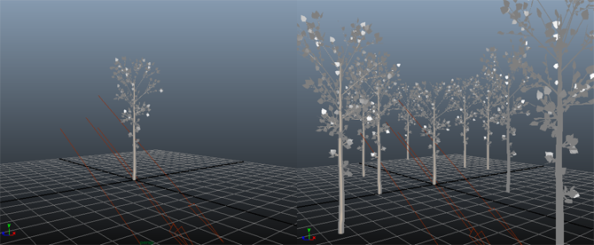
Model matrix
Transforms mesh objects from local (object) space to world space
Each mesh has its own model matrix
Place meshes in the world (or scene) at a position, scale, and orientation
Linear transformations (scaling, rotation, translation) in a 4x4 matrix
https://www.scratchapixel.com/lessons/3d-basic-rendering/transforming-objects-using-matrices

Slide 12
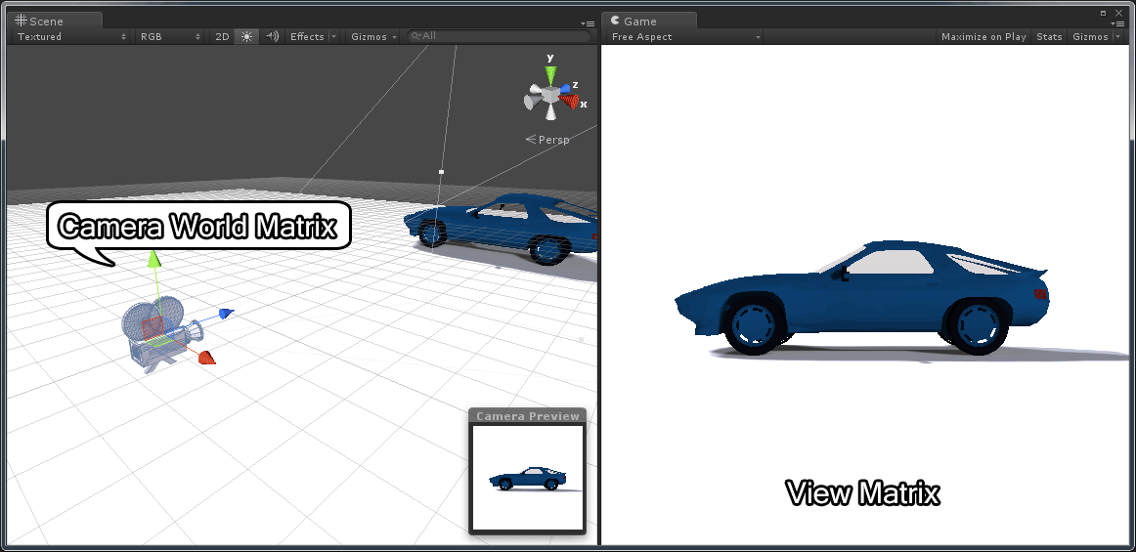
View matrix
Transforms mesh objects from world space to view (or camera) space
Places meshes to be viewed from a camera inside the world
Defines the camera position and orientation
https://www.3dgep.com/understanding-the-view-matrix/

Slide 13
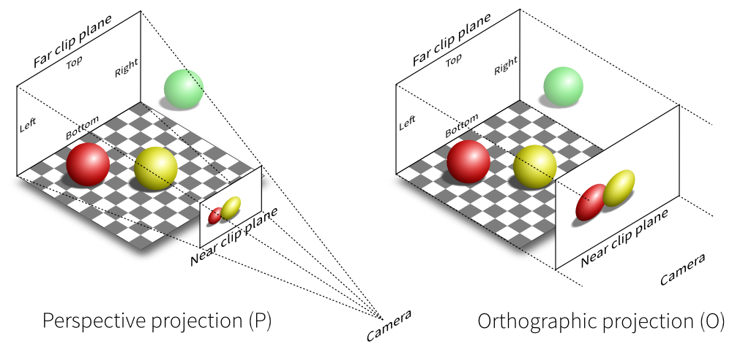
Projection matrix
Transforms mesh objects from view space to clip space
Defines a viewing volume
Vertices or primitives outside of this volume are clipped and not rasterized
Projects 3D coordinates to the 2D plane
http://vispy.org/modern-gl.html

Slide 14
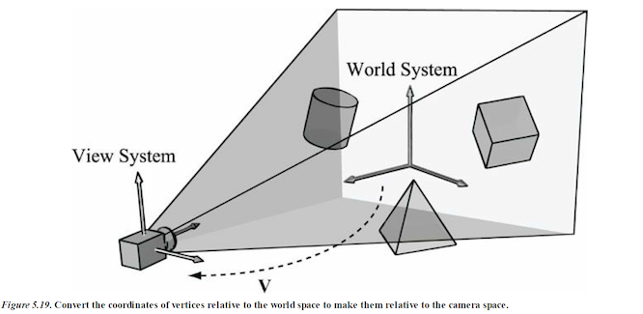
Perspective camera system
Define the view matrix and projection matrix
View matrix components
View position (view point)
View direction (image plane normal)
Up vector (global Y or Z axis)
Perspective projection matrix components
Field of view
Aspect ratio of image plane
Near and far planes
Distance to view point
http://ycpcs.github.io/cs470-fall2014/labs/lab07-2.html

